Slide 1
Embedded Ethics: Disability and
Software Accessibility
Module 2
Notes:
Licensed by the University of Toronto Embedded Ethics Education Initiative, Lindsey Shorser, Jonathan Calver and Paul Gries under the Attribution-NonCommercial-ShareAlike 4.0 International license. To view a copy of this license, visit https://creativecommons.org/licenses/by-nc-sa/4.0/.
Photo by Vitaly Vlasov from Pexels (https://www.pexels.com/photo/person-pointing-numeric-print-1342460/)
Photo by Charl Durand from Pexels (https://www.pexels.com/photo/the-thinker-statue-in-rodin-museum-france-6486112/)

Slide 2
A Quick Refresher of Module 1
Notes:
-> According to the medical model, the impairment causes the limitation, and the human world is a background condition – something that is necessary for the impairment, but not the cause. For example, it would say that someone’s paraplegia causes them to not be able to access public spaces.
-> According to the social model, the human world (human institutions, human habits, human constructions) cause the limitation, and the impairment is a background condition – something that is necessary for the impairment, but not the cause. For example, it would say that the lack of ramps is what causes people with paraplegia not to access public spaces.
How you conceptualize disability matters!

Slide 3
Most people would say that there is an obligation to offer reasonable accommodation to people with disabilities.
Notes:
Last class, we talked about what disability is, and how to conceptualize it. Today we’re going to talk about what to do it about it – accommodation. A familiar example: academic accommodations .
Image by Sasin Tipchai from Pixabay (https://pixabay.com/photos/sunset-men-silhouettes-helping-1807524/)

Slide 4
On the medical model, this will mean removing the traits that cause the limitations.
Prosthetic limbs
Cognitive Therapy
Braille translation software
Notes:
[Explain how one of them illustrates the medical model – e.g. prosthetic limbs (makes it the case that the impairment no longer causes the limitation, regardless of how the human world is arranged]
Image Source: cottonbro at Pexels (https://www.pexels.com/photo/person-in-black-pants-and-black-shoes-sitting-on-brown-wooden-chair-4101143/)

Slide 5
On the social model, this will mean redesigning the physical and social environment to make the trait no longer result in limitations.
Wheelchair ramps
Widespread knowledge of sign language
Text-to-speech features
Changing social conventions / attitudes to remove stigma around disability
Notes:
Image Source: Tima Miroshnichenko from Pexels (https://www.pexels.com/photo/a-blind-man-looking-up-while-touching-a-braille-book-6609408/)

Slide 6
Question for Discussion
Putting it into words: Why do you think that it is important to accommodate people with disabilities?
Notes:
Very open-ended question. A lot of students here respond with moral answers – e.g. fairness, treating people as human, etc. Good to comment on this, because this contrasts with other prudential or legal reasons.
Image Source: Robin Higgins at pixabay (https://pixabay.com/photos/thinking-person-person-thinking-2681494/)

Slide 7
Part 1:
The Morality of Accommodation
Notes:
Photo by Jens Johnsson: https://www.pexels.com/photo/brown-wooden-arrow-signed-66100/

Slide 8
It is important to think about the impacts your applications will have on other people (and society as a whole).
One impact: Your application will create some things, and redistribute some things, both to your users and to other stakeholders.
Notes:
Image by PublicDomainPictures from Pixabay (https://pixabay.com/photos/cardboard-box-paper-old-close-up-314504/)

Slide 9
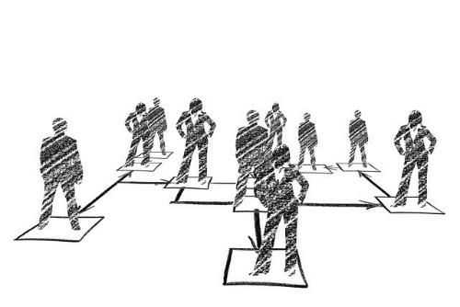
Some things created and redistributed by apps
Happiness
Resources
Status
Capabilities
Notes:
Happiness Image by StartupStockPhotos from Pixabay ((https://pixabay.com/photos/children-win-success-video-game-593313/)
Status Image by Gerd Altmann from Pixabay (https://pixabay.com/photos/hierarchy-people-man-woman-2499789/)
Capabilities Image by Anja from Pixabay (https://pixabay.com/photos/child-boy-dragon-dragon-flight-2887483/)
Resources Image by Julita from Pixabay (https://pixabay.com/photos/america-the-dollar-president-3125467/)

Slide 10
Question for Discussion
What does Uber create and redistribute to its users (and other stakeholders)?
[Oral participation or Mentimeter word cloud]
Notes:
Image Source: Robin Higgins at pixabay (https://pixabay.com/photos/thinking-person-person-thinking-2681494/)
Some answers: capabilities to go from place A to place B, gives some people money…

Slide 11
Question for Discussion
What does Instagram create and redistribute to its users (and other stakeholders)?
[Oral participation or Mentimeter word cloud]
Notes:
Image Source: Robin Higgins at pixabay (https://pixabay.com/photos/thinking-person-person-thinking-2681494/)
Possible answers: social opportunities, etc
At this point, it’s a good idea to ask for a couple students to talk about the apps that they’re designing for CSC207. Have a couple students just describe those apps. What do those apps create and redistribute?

Slide 12
Now I'm going to give you another example from my own life. In the '90s, people around me started talking about the Internet and web browsing. I remember the first time I went on the web. I was astonished. I could access newspapers at any time and every day. I could even search for any information by myself. I desperately wanted to help the blind people have access to the Internet, and I found ways to render the web into synthesized voice, which dramatically simplified the user interface.
This led me to develop the Home Page Reader in 1997, first in Japanese and later, translated into 11 languages.
- Chieko Asakawa, computer scientist
Notes:
[Here is one example of an app that creates and redistributes: it gives access to information to visually impaired people who previously did not have it.]
Chieko Asakawa’s TED Talk is here: https://www.ted.com/talks/chieko_asakawa_how_new_technology_helps_blind_people_explore_the_world/transcript?referrer=playlist-designing_for_disability&autoplay=true
Photo credit: https://en.wikipedia.org/wiki/Chieko_Asakawa#/media/File:Field_experiment_in_Nihonbashi,_Tokyo_(Feb_2017)_1-19_screenshot.png

Slide 13
Any time we distribute things, this raises moral considerations of distributive justice.
Notes:
Image by Nome Visualizzato from Pixabay (https://pixabay.com/photos/justice-scales-symbolism-themis-4592723/)

Slide 14
(Some) elements of distributive justice
Rights to a minimum: making sure everyone has a bare minimum of something
Efficiency: making sure resources are allocated to where they are used most effectively.
Equality/equity: making sure everyone gets the same amount of resources/capabilities
Luck egalitarianism: making sure that no one is deprived of resources for reasons they are not responsible for.
Notes:
[Some examples of luck egalitarianism: someone shouldn’t be deprived of resources/opportunities just because of their race, natural abilities, etc. But we can still allow for differences on the basis of how hard you work, etc]
Photo Sources (from top left, counter-clockwise):
Image 1 Source: Marvin Meyer at unsplash (https://unsplash.com/photos/SYTO3xs06fU)
Image 2 Source: Clay Banks at unsplash.com (https://unsplash.com/photos/qT7fZVbDcqE)
Image 3 Source: Djalma Paiva Armelin: https://www.pexels.com/photo/shallow-focus-photography-of-four-leaf-clover-705310/
Image 4 Source: Thought Catalogue on unsplash.com (https://unsplash.com/photos/fnztlIb52gU)

Slide 15
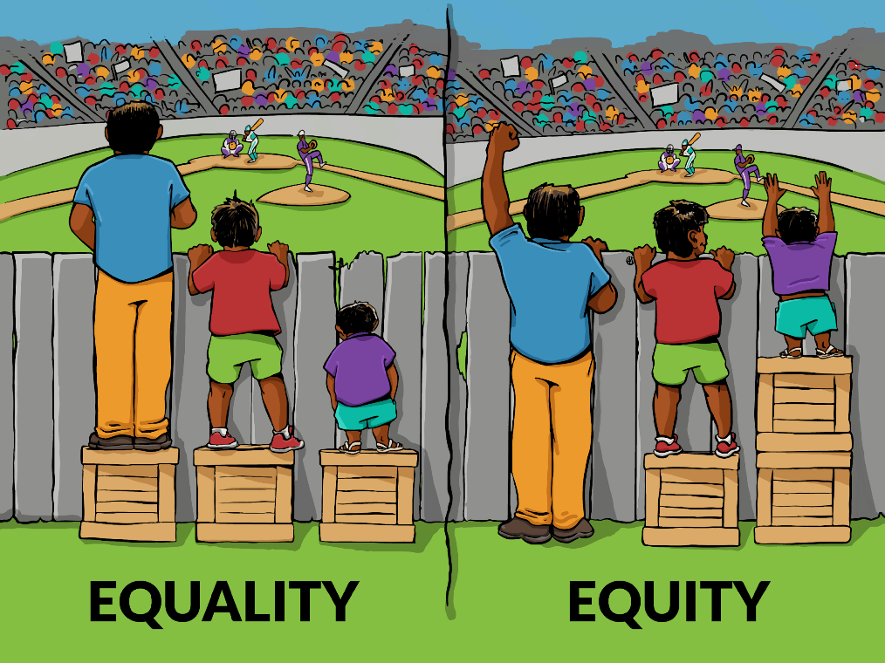
Equality or Equity
Notes:
Image Source: https://interactionninstitute.org/illustrating-equality-vs-equity/
(Equality is about dividing resources equally between people; equity is about (1) distributing a fixed pot of resources according to need, or (2) making sure everyone has the same outcome / access, equity is also potentially about removing obstacles]

Slide 16
Question for Discussion
In the following cases, which factor above (or none of them) do you think is most important for how we should distribute it?
The right to vote
Shelter
Sports cars
[poll]
Notes:
Image Source: Robin Higgins at pixabay (https://pixabay.com/photos/thinking-person-person-thinking-2681494/)

Slide 17
Question for Discussion
Out of {efficiency, rights to a minimum, equality, luck egalitarianism}, which best explains why you personally think it is important to put resources towards improving accessibility?
[poll, verbal discussion of it]
Notes:
Image Source: Robin Higgins at pixabay (https://pixabay.com/photos/thinking-person-person-thinking-2681494/)
Equality vs equity in discussion

Slide 18
Question for Discussion
We want to explore the question: Is morality enough to guarantee the production of accessible products?
What pressures might designers face, leading them to settle for a less accessible product?
[Oral participation or Mentimeter word cloud]
Notes:
Image Source: Robin Higgins at pixabay (https://pixabay.com/photos/thinking-person-person-thinking-2681494/)

Slide 19
Morality is important, but it has limits.
Morality is not necessarily enforced.
Not everyone follows their moral reasons.
There is substantial disagreement about morality.
Notes:
Image by Cloé Gérard from Pixabay (https://pixabay.com/users/poupoune05-405)5465/
The idea here: letting people know about their moral duties is not the only way we should respond to the need for accomodation. We should also add legal obligations.

Slide 20
Part 2:
The Law of Accommodation
Notes:
Photo by Jens Johnsson: https://www.pexels.com/photo/brown-wooden-arrow-signed-66100/

Slide 21
There are legal obligations to accommodate people with disabilities.
Legal requirements are backed by some kind of legal penalty (e.g. a fine).
Legal requirements are usually contained in a legal code.
Morality and law overlap, but they are not identical:
Morally Required
Legally Required
Notes:
Photo by Sora Shimazaki: https://www.pexels.com/photo/judgement-scale-and-gavel-in-judge-office-5669602/

Slide 22
Canadian Charter of Rights and Freedoms
15. (1) Every individual is equal before and under the law and has the right to the equal protection and equal benefit of the law without discrimination and, in particular, without discrimination based on race, national or ethnic origin, colour, religion, sex, age or mental or physical disability.
However, the Charter (mostly) only protects against discrimination by the state or government.
Notes:
[In general, the charter is a document that protects certain fundamental rights and freedoms for Canadians – e.g. freedom of conscience, freedom of speech. But it also guarantees that the government cannot discriminate against people.]
Photo credit: https://lop.parl.ca/About/Parliament/Education/OurCountryOurParliament/html_booklet/canadian-charter-rights-and-freedoms-e.html

Slide 23
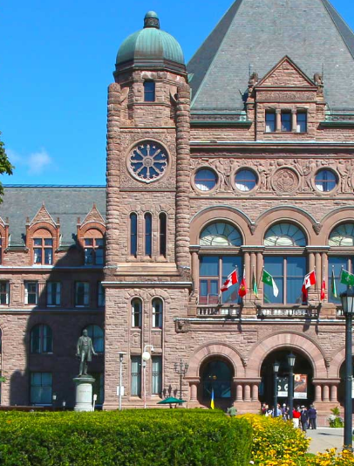
Accessibility for Ontarians with Disabilities Act (AODA)
In 2021, new regulations came into effect for websites.
Most public and private organizations in Ontario are expected to make their websites compliant with Web Content Accessibility Guidelines 2.0 to the “AA” level (which includes the lower “A” level, too. (https://www.ontario.ca/page/how-make-websites-accessible)
Corporations can be fined up to $100,000 a day for non-compliance.
Individuals can be fined up to $50,000 a day for non-compliance.
Notes:
[Mention that Lindsey will say a little bit about the Guidelines]

Slide 24
AODA
AODA website:
“Accessibility is good for both the economy and the community. The population of Ontarians with disabilities is steadily growing. Accessible information and employment make it possible for this growing group of people to contribute to the economy and society…. Similarly, accessible customer service allows people to exercise their spending power.” (https://aoda.ca/what-is-the-aoda/)

Slide 25
AODA
AODA website:
“Finally, the standards of the AODA give all people an equal footing as they work, play, learn, teach, buy, sell, and use their diverse talents to benefit their communities and their province.” (https://aoda.ca/what-is-the-aoda/)

Slide 26
Question for Discussion
What moral values do you see reflected in the government’s arguments for AODA – efficiency, right to a minimum, strict equality, luck egalitarianism, or others?
Notes:
[Some answers: efficiency “good for the community”, “allows people to exercise their spending power” – also equality “equal footing”]
Image Source: Robin Higgins at pixabay (https://pixabay.com/photos/thinking-person-person-thinking-2681494/)

Slide 27
Part 3:
Professionalism and Accommodation
Notes:
Photo by Jens Johnsson: https://www.pexels.com/photo/brown-wooden-arrow-signed-66100/

Slide 28
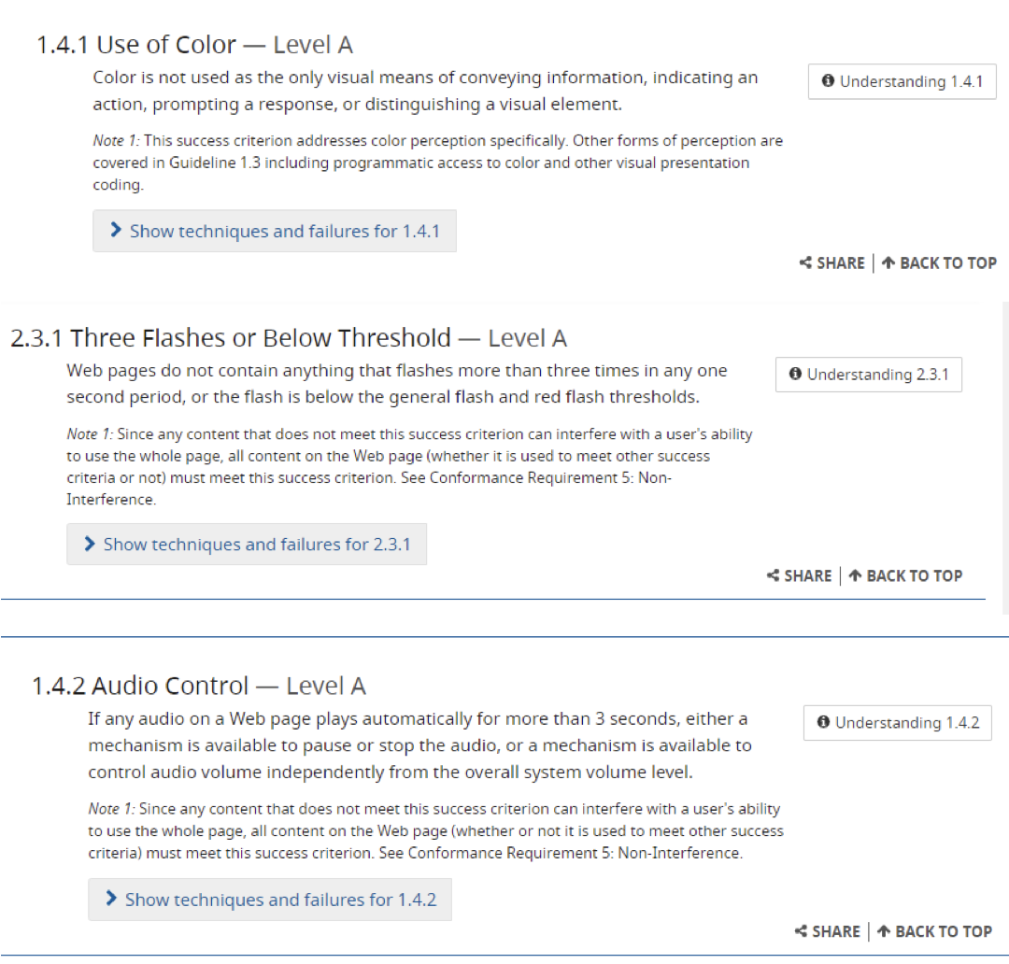
Some of Our
Legal Responsibilities
https://www.ontario.ca/page/how-make-websites-accessible These guidelines are based on https://www.w3.org/WAI/standards-guidelines/wcag/
Notes:
-> look at the kind of detail you’re getting! There is good guidance to be had — you don’t have to make it up as you go along.
-> they are legal responsibilities for public and major private organization (though not for all apps — e.g. if you put an app on the google store)
-> These are Ontario government guidelines. Ontario borrowed them from a non-profit organization (https://www.w3.org/WAI/standards-guidelines/wcag/) that created a set of guidelines.
Screenshot Sources:
https://www.w3.org/TR/UNDERSTANDING-WCAG20/visual-audio-contrast-without-color.html
https://www.w3.org/TR/UNDERSTANDING-WCAG20/seizure-does-not-violate.html
https://www.w3.org/TR/UNDERSTANDING-WCAG20/visual-audio-contrast-dis-audio.html

Slide 29
The Professional Answer (Code of Ethics)
I. To uphold the highest standards of integrity, responsible behavior, and ethical conduct in professional activities.
to hold paramount the safety, health, and welfare of the public, to strive to comply with ethical design and sustainable development practices, to protect the privacy of others, and to disclose promptly factors that might endanger the public or the environment;
Institute of Electrical and Electronics Engineers
https://www.ieee.org/about/corporate/governance/p7-8.html
Notes:
Professional organizations, like the IEEE, have published codes of ethics. For example, the IEEE has this to say about their members’ responsibility to ethical design.
[rough notes, this is somewhat of an aside and can be rushed as needed]
The IEEE would have a lot of say if there were ever an accreditation process. They would be contributing heavily to the requirements. If you want to be one of these highly trained professionals, these are guidelines you should follow. It may become mandatory.
This is also about thinking about yourself as a professional.

Slide 30
The Professional Answer (Code of Ethics)
II. To treat all persons fairly and with respect, to not engage in harassment or discrimination, and to avoid injuring others. 7. to treat all persons fairly and with respect, and to not engage in discrimination based on characteristics such as race, religion, gender, disability, age, national origin, sexual orientation, gender identity, or gender expression;
Institute of Electrical and Electronics Engineers
https://www.ieee.org/about/corporate/governance/p7-8.html
The University and other organizations also have similar policies (codes of conduct):
https://governingcouncil.utoronto.ca/secretariat/policies/code-student-conduct-december-13-2019
Notes:
Codes of ethics (or conduct) are of course not unique to the IEEE. As a student and a member of the university of community we are responsible for acting in a way that is consistent with the university’s established code of conduct.

Slide 31
Clean Architecture and Accessibility
Clean Architecture (or other layered architectures) makes it easier to update the accessibility features of your program.
Why? Because they should mostly be located in the outer layer.
Notes:
[rough notes for ideas to discuss]
Most accessibility features to address physical disabilities should only require changes to the user interface. If we have designed our software following Clean Architecture, then implementing such features can be done independently of the core logic of the program!
Many of you have started working on GUIs for your projects and are hopefully seeing firsthand that the UI is in and of itself a substantial undertaking — requiring many hours to become familiar with what is available to you. If you have enjoyed your experience with developing a UI so far, you should consider taking an HCI course to deepen your understanding of the area. Expertise in designing usable interfaces may help you find a career in the future!
(If time, can possibly pose the question of “what is an example of a feature that might require changes to the core of the program?”)

Slide 32
Designing Accessible Software
You are not expected to figure this out on your own.
1. Accessibility checkers
2. Companies often hire consultants and/or beta testers. An excellent way to learn about someone's experience of using your software is to ask them. This is especially true if they have a disability that you have not experienced.
Example of a consulting company that specializes in testing, including for accessibility purposes: https://www.ibeta.com/accessibility-testing/"

Slide 33
Summary
Your products distribute things, and so it is important to think about distributive justice.
There are many reasons to make products accessible:
Moral reasons (distributive justice, others…)
Legal reasons (the Charter of Rights and Freedoms, AODA)
Professional reasons

Slide 34
Acknowledgements
This module was created as part of an Embedded Ethics Education Initiative (E3I), a joint project between the Department of Computer Science¹ and the Schwartz Reisman Institute for Technology and Society², University of Toronto.
Instructional Team:
Philosophy: Steven Coyne, Emma McClure
Computer Science: Lindsey Shorser, Paul Gries, Jonathan Calver
Faculty Advisors:
Diane Horton¹, David Liu¹, and Sheila McIlraith^{1,2}
Department of Computer Science
Schwartz Reisman Institute for Technology and Society
University of Toronto

Slide 35
References
Canadian Charter of Rights and Freedoms, URL= https://www.canada.ca/en/canadian-heritage/services/how-rights-protected/guide-canadian-charter-rights-freedoms.html#a2f.
Putnam, Daniel, David Wasserman, Jeffrey Blustein, and Adrienne Asch, "Disability and Justice", The Stanford Encyclopedia of Philosophy (Fall 2019 Edition), Edward N. Zalta (ed.), URL = https://plato.stanford.edu/archives/fall2019/entries/disability-justice/.
Robeyns, Ingrid and Morten Fibieger Byskov, "The Capability Approach", The Stanford Encyclopedia of Philosophy (Fall 2021 Edition), Edward N. Zalta (ed.), URL = https://plato.stanford.edu/archives/fall2021/entries/capability-approach/.
Thomson, Greg. “What is the AODA?” URL= https://aoda.ca/what-is-the-aoda/

